Slide 1







AIPOWERED PATIENT REGISTRATION & DATA OPTIMIZATION
Submitted by
ANBU U 512220104003
GOPINATH A 512220104011
NITHIN PRITHIV J 512220104023
VASANTHAKUMAR A 512220104034 ……………………..................................................................
GUIDE
MRS. S. KALPANA Asst.Prof/CSE
Department of Computer Science

Slide 2


AGENDA:
Abstract
Existing System
Dis-advantage
Proposed System
Advantage
Software and hardware Requirements
Interface and Constraints
Phase of Projects and Gantt Chart
Architecture Diagram
DFA Diagram
Use-Case Diagram
ER – Diagram
Class Diagram and Sequence Diagram
List of Modules
Output
Future Enhancement
Conclusion

Slide 3
ABSTRACT
This abstract highlights the synergy between AIpowered patient registration systems and data optimization strategies in healthcare. Leveraging AI algorithms streamlines registration processes, ensuring accuracy and reducing administrative burdens. Concurrently, data optimization techniques analyze registration data, empowering proactive resource allocation and personalized care delivery. Together, these innovations drive operational efficiency and enhance patient experiences, marking a transformative shift in healthcare delivery.

Slide 4





EXISTING SYSTEM
Manual Data Entry: The current system relies heavily on manual data entry processes during patient registration, which are prone to errors and inefficiencies.
Limited Data Utilization: Healthcare institutions often underutilize the data collected during registration, missing opportunities for insights into patient demographics, preferences, and needs.
Fragmented Workflow: The registration process is often fragmented, involving multiple departments and systems, leading to disjointed experiences for both patients and healthcare staff.
DRAWBACKS
PAPER-BASED FORMS
LIMITED DATA ANALYSIS
LIMITED ACCESSIBILITY
STAFF WORKLOAD & LACK OF INTEGRATION

Slide 5
PROPOSED SYSTEM
Automated Registration: Implementing AI-powered registration systems to automate data entry processes, reducing errors and streamlining the registration experience for patients and staff.
Integrated Platform: Developing a unified registration platform that seamlessly integrates with other hospital systems, allowing for real-time data sharing and enhancing operational efficiency.
Personalized Experiences: Utilizing AI algorithms to analyze registration data and provide personalized experiences for patients, such as tailored appointment scheduling and customized communication preferences.
MERITS
AI-DRIVEN DATA ENTRY
INTELLIGENT VERIFICATION
DIGITAL FORMS
SELF-SERVICE OPTIONS

Slide 6
SOFTWARE REQUIREMENT
Operating System : Windows 7 or Higher
Coding Language: python 3.8.4
Database : MY_SQL
Software Using : pythonkivy,Cv2,
Face Recognition , PYTTSX3
Editor : VS Code / Anyother Text Editor

Slide 7
INTERFACE
Voice Recognition: Implement voice recognition technology to allow patients to register by speaking their details. This feature enhances accessibility, especially for individuals with disabilities or those who prefer voice input over typing
Touchscreen : Install touchscreen kiosks in healthcare facilities where patients can register themselves upon arrival. The interface should be userfriendly and guide patients through the registration process step by step.
Online Forms: Provide online forms that patients can fill out from the comfort of their homes before their appointment. Ensure that the forms are easy to access, fill, and submit securely over the internet

Slide 8
CONSTRAINTS
Regulatory Approval and Certification
Network Connectivity
User Experience (UX)
Accessibility
Data Accuracy and Validation
Security and Privacy Regulations

Slide 9
HARDWARE REQUIREMENT
Processor : Intel Core i3 or Higher/AMD Processors
RAM : 4GB or Higher(Recommended)
Hard Disk : 50GB or Higher(Recommended)

Slide 10
PHASES OF PROJECT
Planning Phase
Identify Requirements:
Patient details
Software requirement
Hardware requirement
Design Phase
System Architecture: Design the overall architecture of the AI patient registration system, including the user interface, backend infrastructure, data storage, and integration with existing systems.
User Interface Design: Create intuitive and userfriendly interfaces for web, mobile, chatbot, and kiosk platforms, considering factors like accessibility and ease of use
Data Model: Define the data model for storing patient information, ensuring compliance with privacy regulations like HIPAA (Health Insurance Portability and Accountability Act).

Slide 11
PHASES OF PROJECT
Development Phase:
Software Development: Develop the registration system software components, including frontend interfaces, backend logic, database integration, and AI algorithms for data processing and validation.
Testing: Conduct thorough testing of the system to identify and fix any bugs or issues. This includes functional testing, usability testing, performance testing, and security testing.
Deployment Phase:
Deployment Planning: Plan the deployment strategy, including rollout schedules, user training, and support procedures.
Monitoring and Maintenance: Establish monitoring procedures to track system performance and user feedback, and implement maintenance processes to address any issues that arise postdeployment.
Evaluation Phase:
Performance Evaluation: Evaluate the performance of the AI patient registration system against predefined metrics, such as registration time, accuracy of data capture, patient satisfaction, and staff productivity.
Feedback Collection: Collect feedback from healthcare staff and patients to identify areas for improvement and refinement.

Slide 12
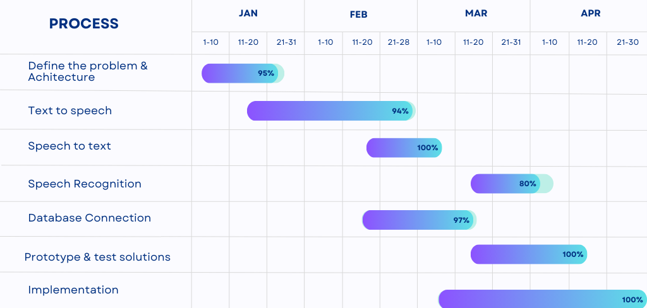
GANTT CHART

Slide 13
ARCHITECTURE DIAGRAM

Slide 14
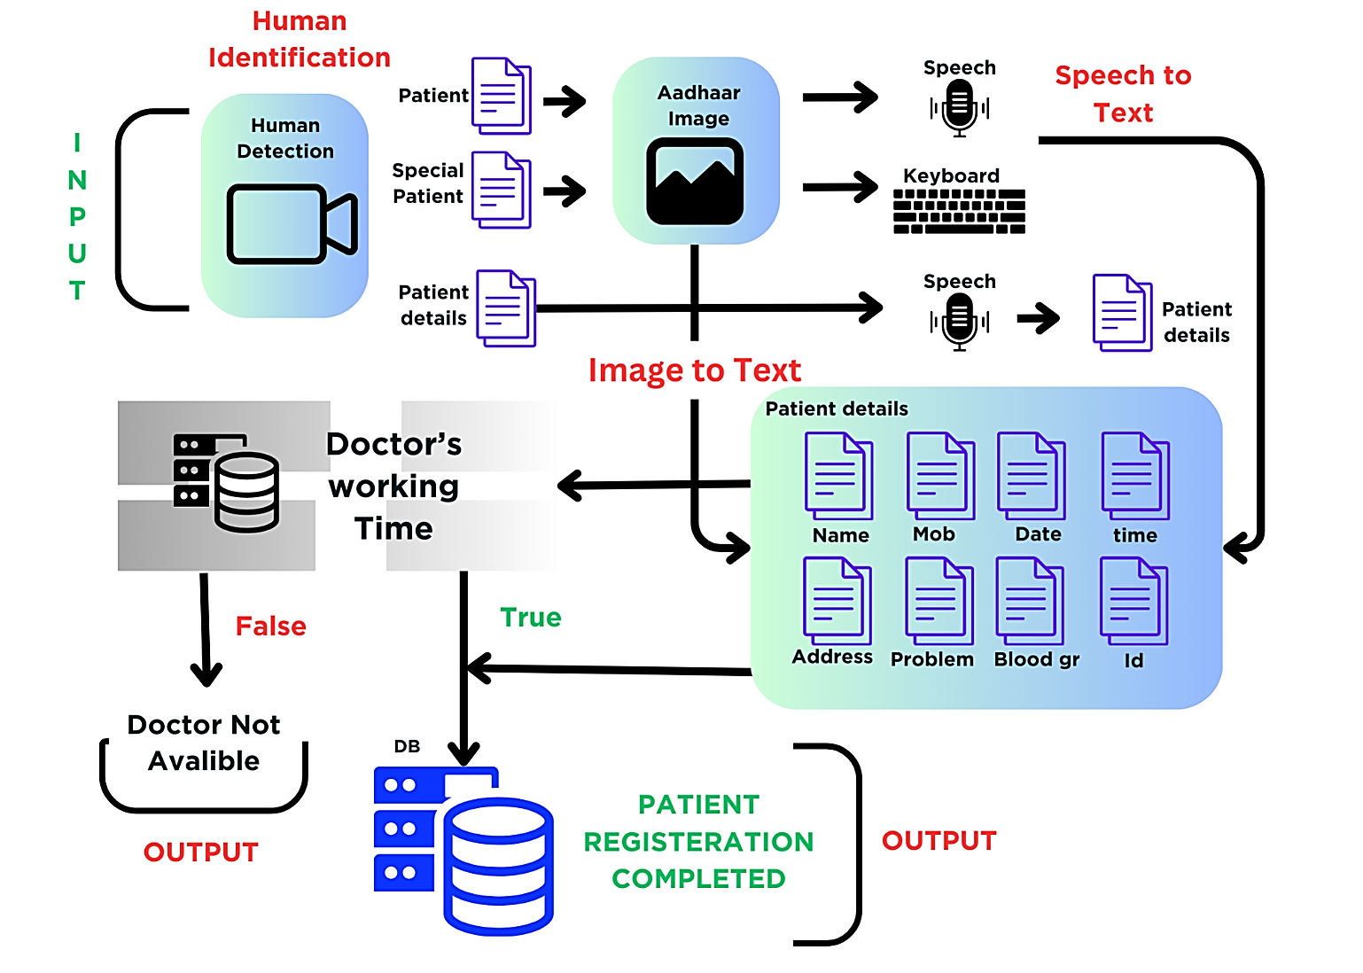

Slide 15
DATA FLOW DIAGRAM

Slide 16
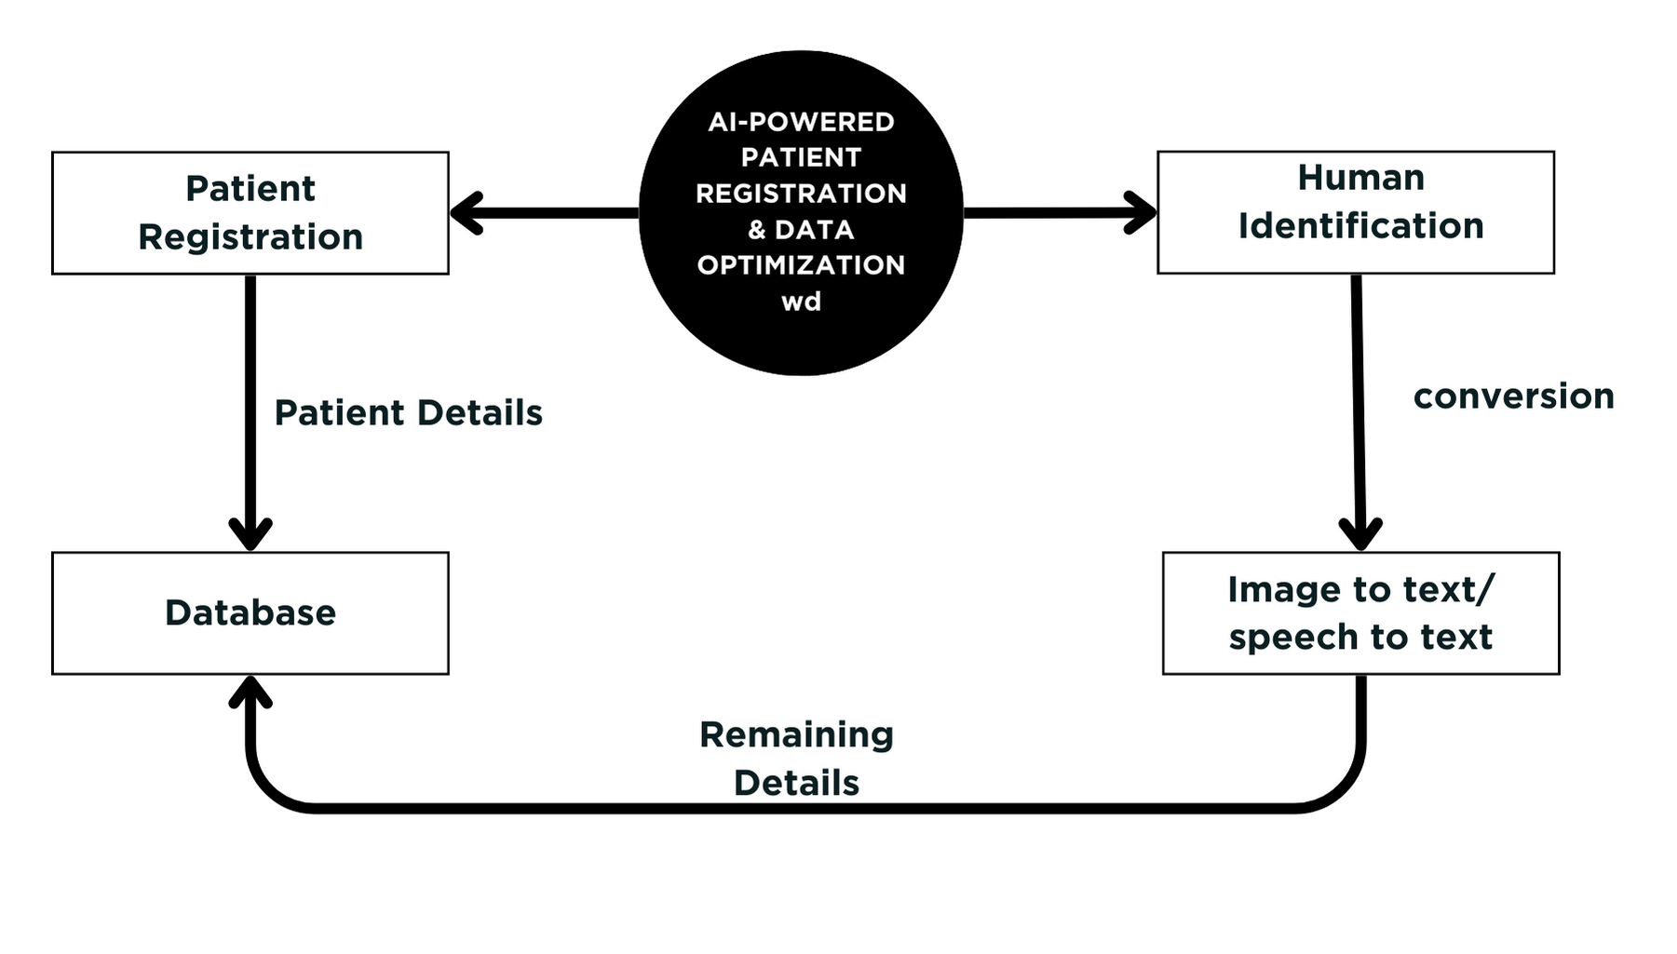
Level 0:

Slide 17
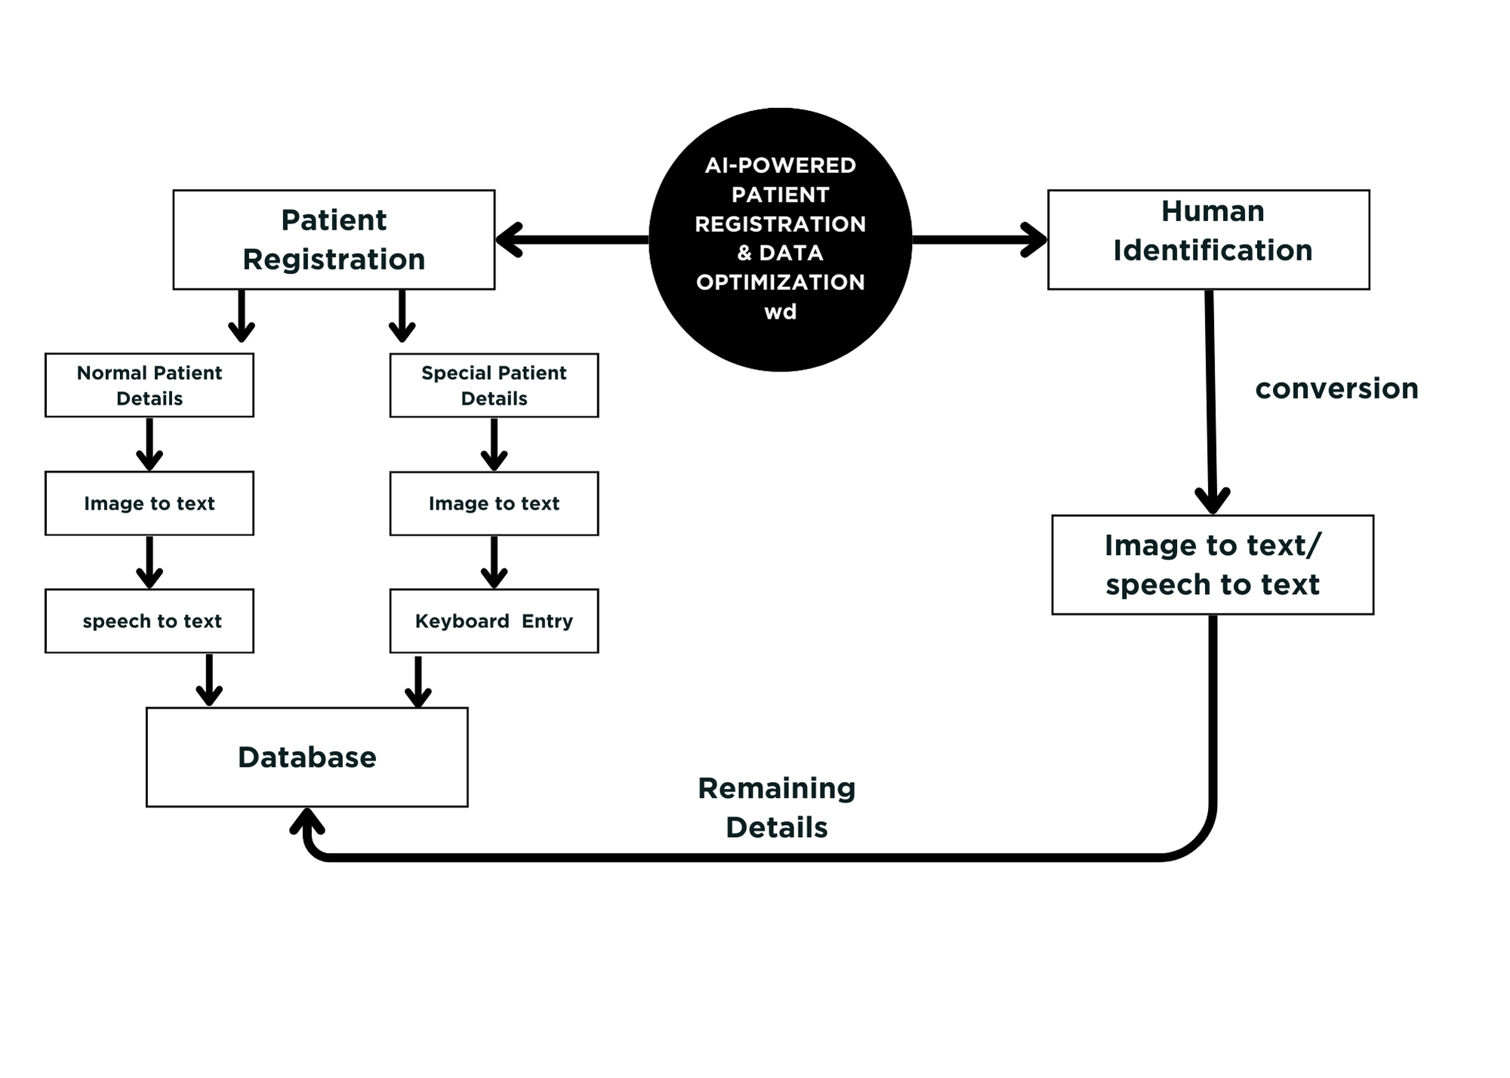
Level 1:

Slide 18
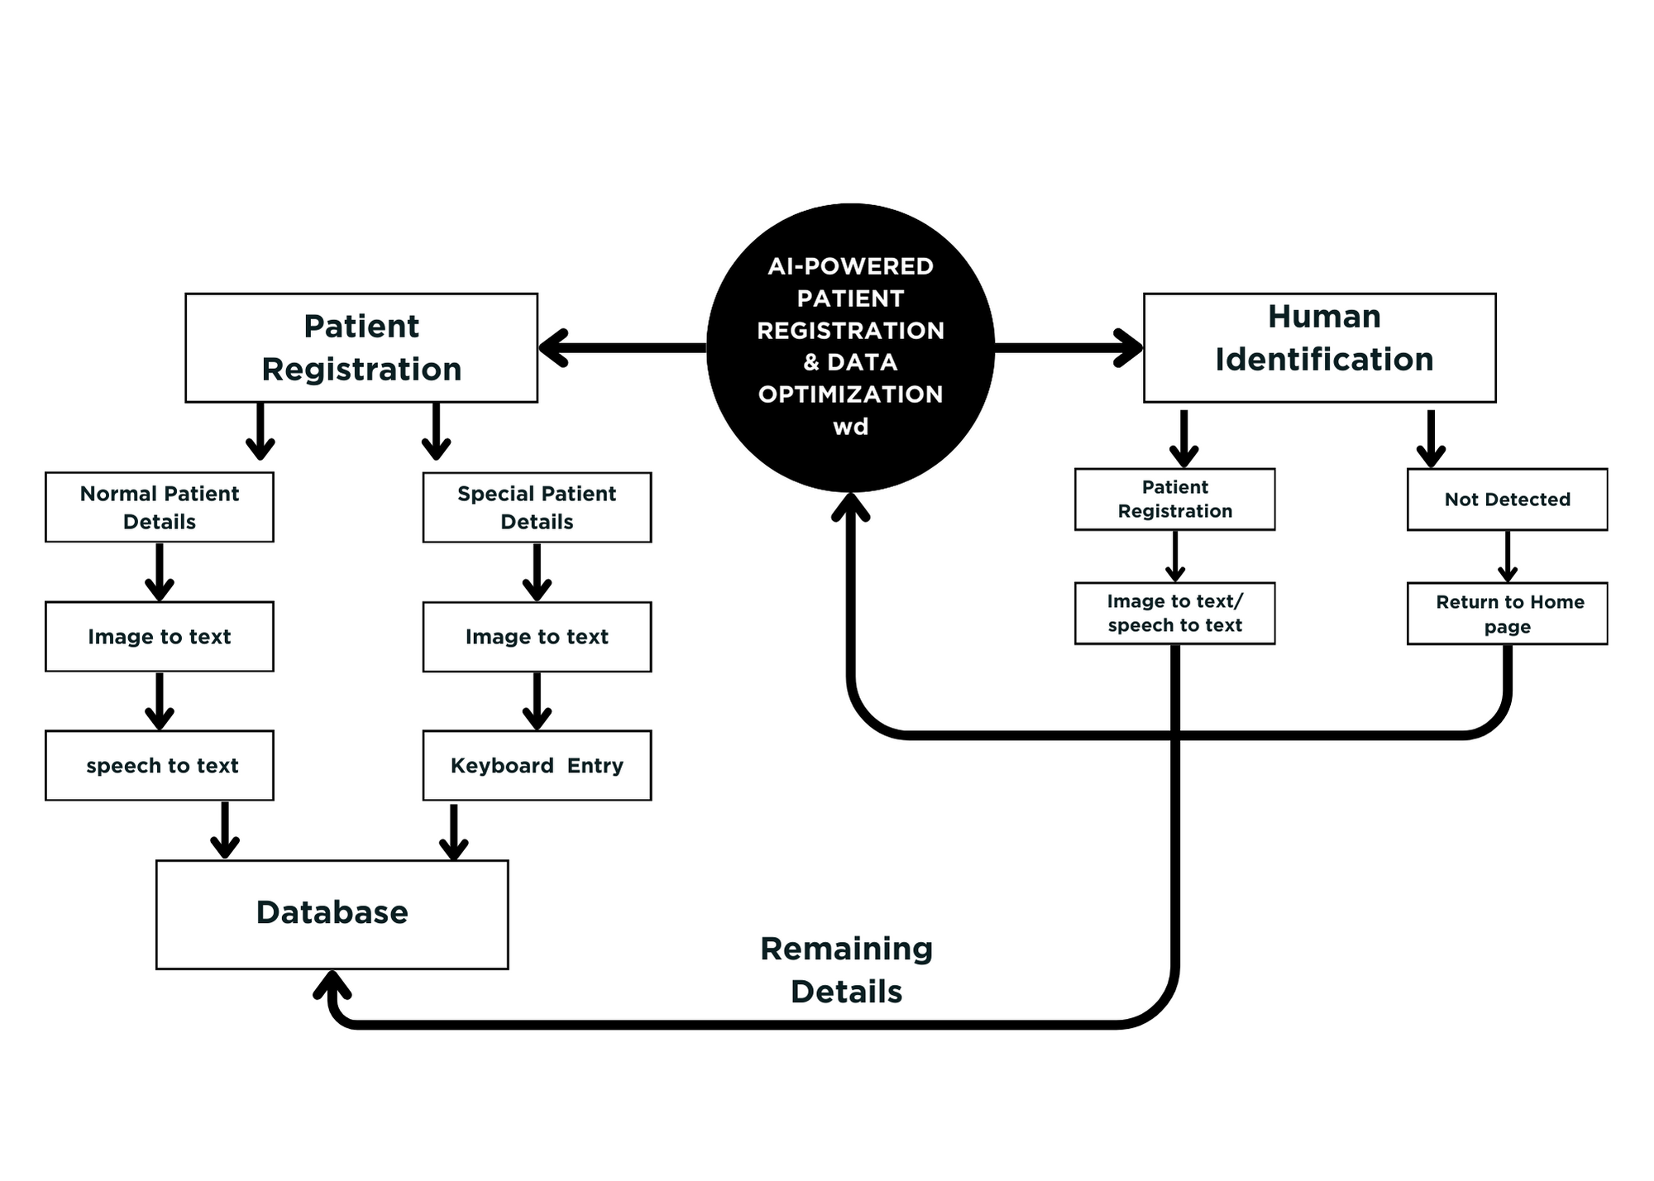
Level 2:

Slide 19
USECASE DIAGRAM

Slide 20
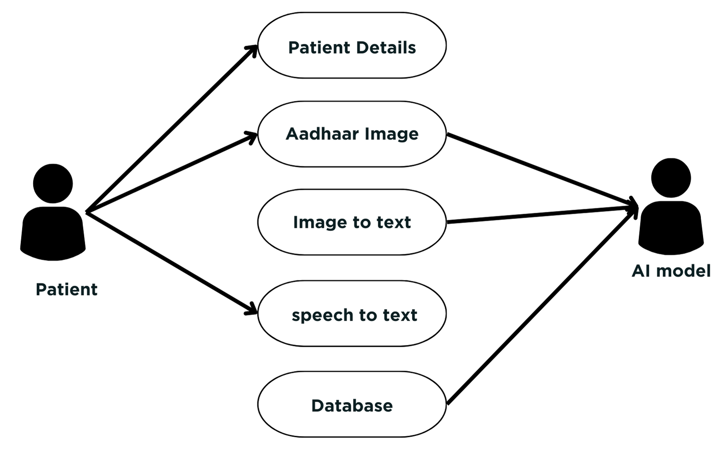

PATIENT-AI:

Slide 21
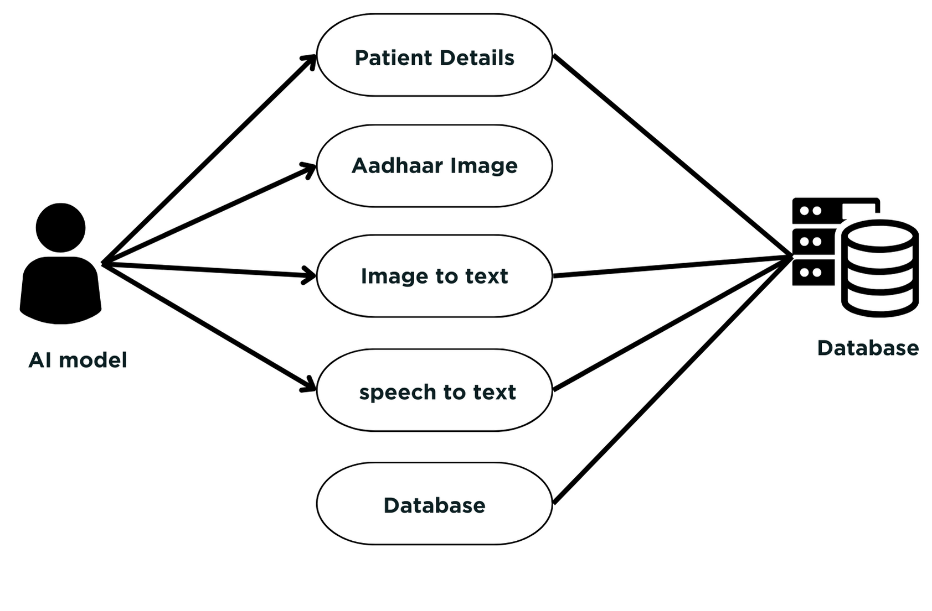
AI- DATABASE:

Slide 22
ER-DIAGRAM

Slide 23
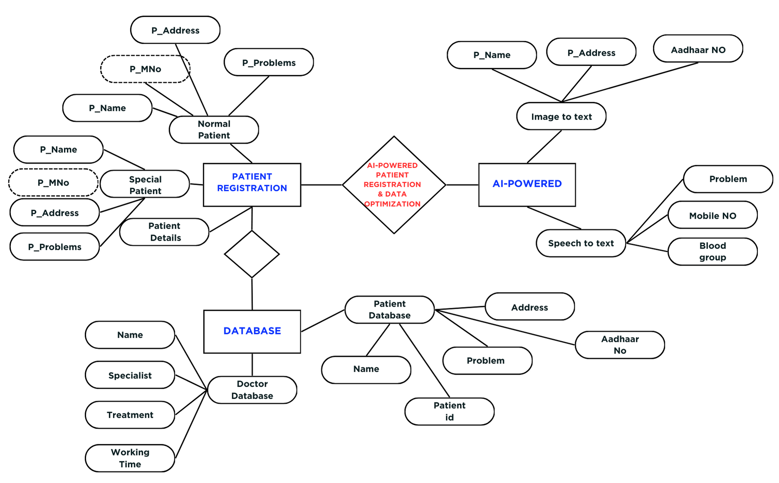
To

Slide 24
CLASS DIAGRAM

Slide 25
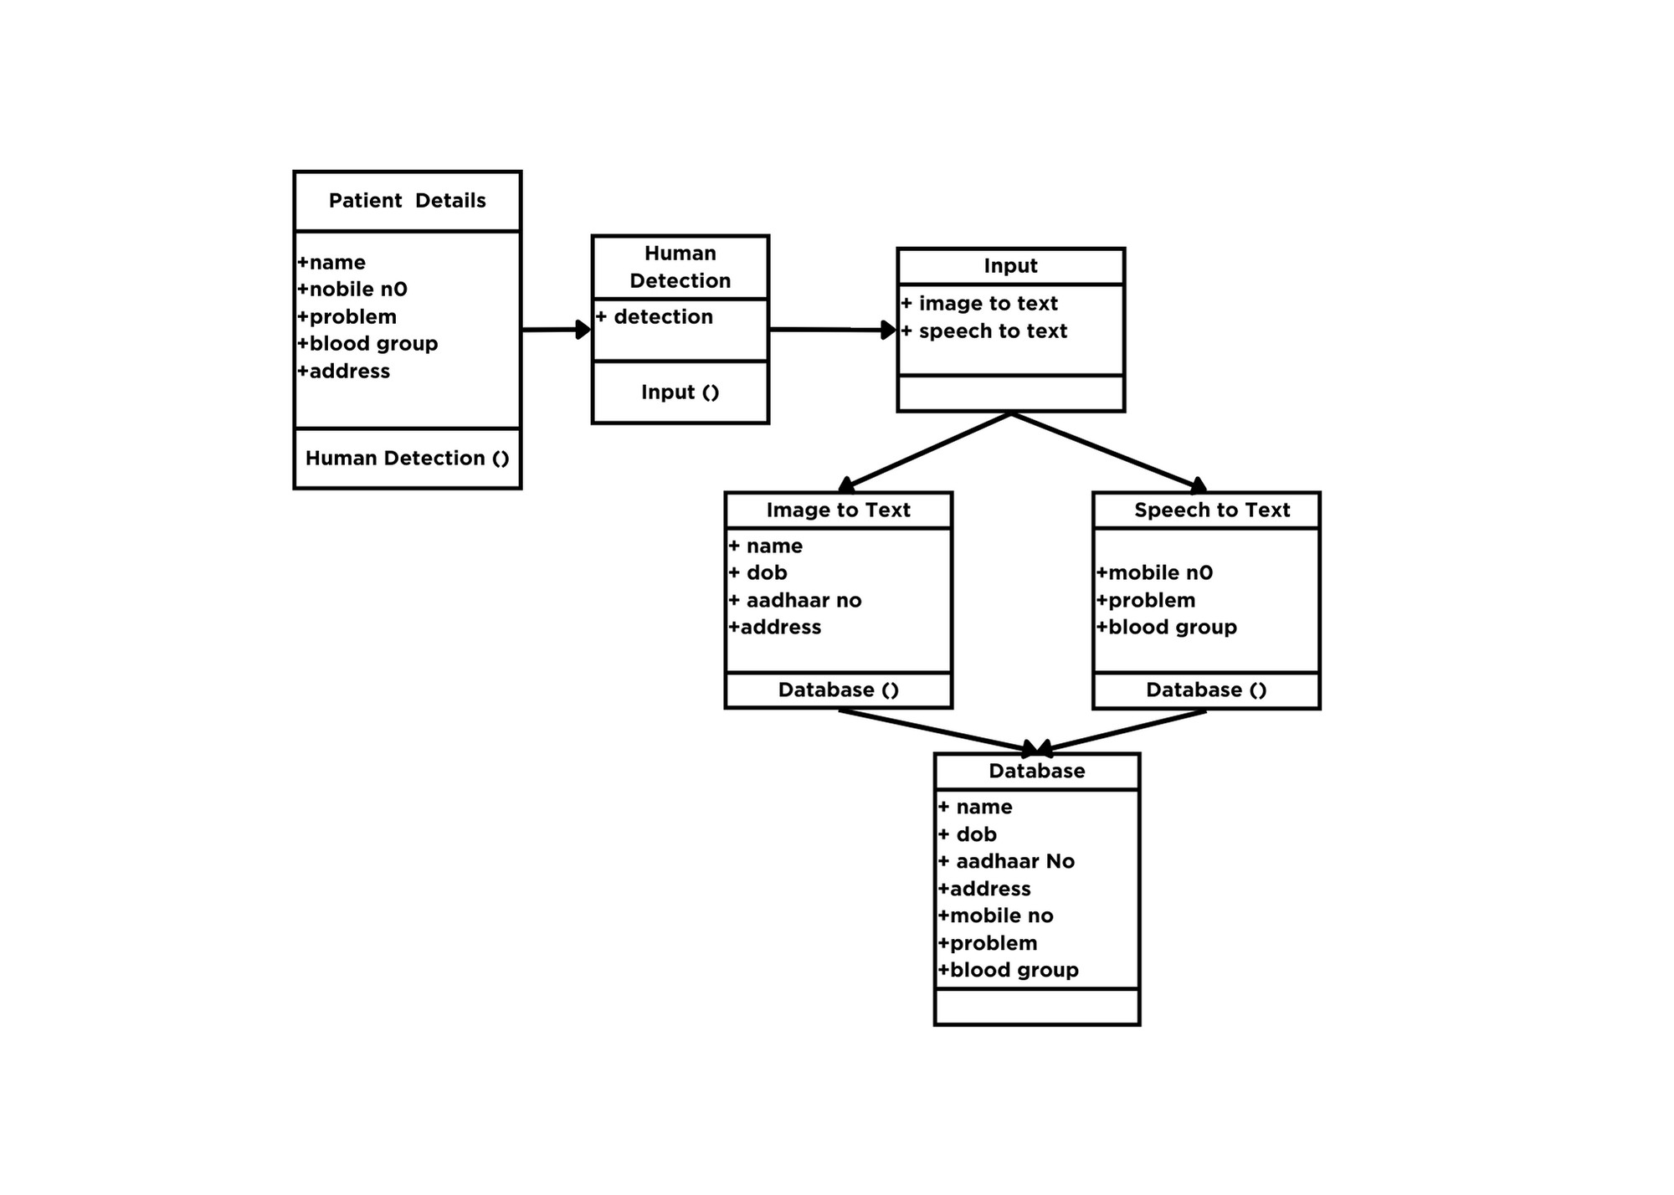

Slide 26
SEQUENCE DIAGRAM

Slide 27
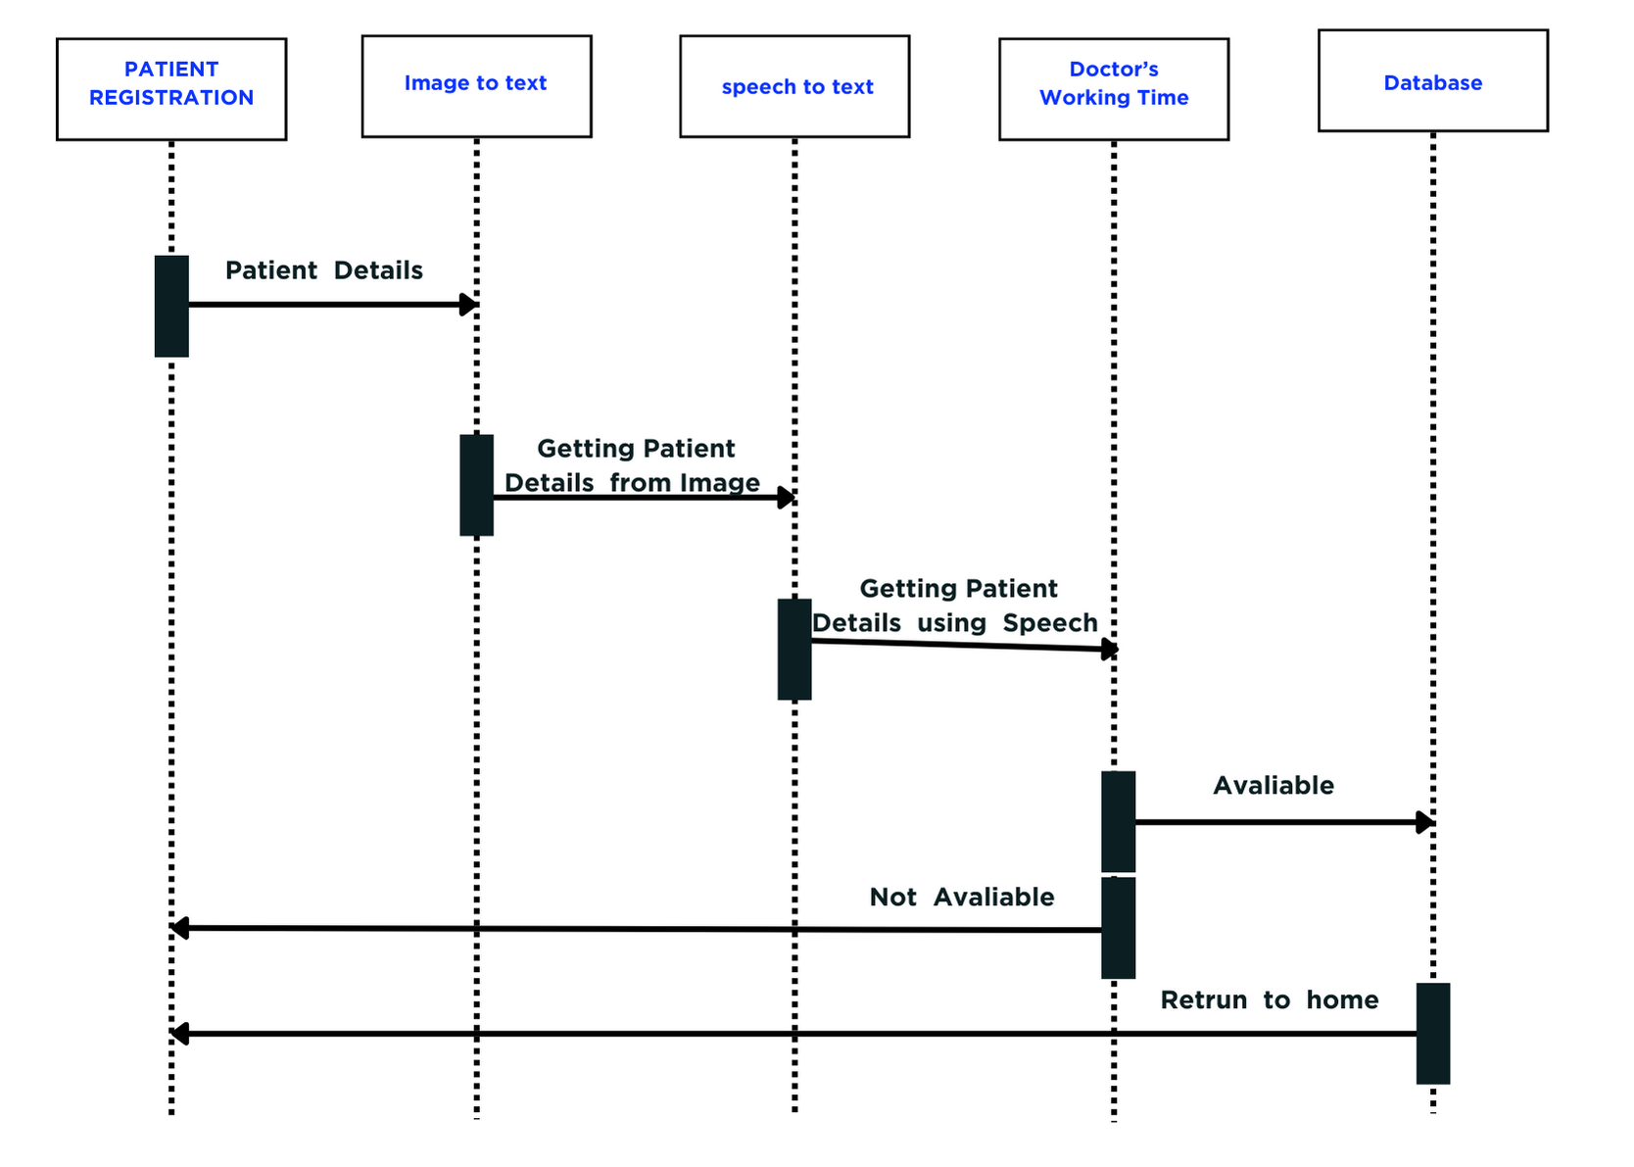

Slide 28
LIST OF MODULES:
Registration Module:
Handles the automated registration of patients, capturing essential demographic and insurance information.
Data Validation Module:
Ensures the accuracy and completeness of patient data through real-time validation and error checking.
Integration Module:
Facilitates the integration of healthcare data from various sources and systems, e nsuring interoperability and comprehensive access to patient information.
Security Module:
Implements robust encryption protocols, access controls, and other security measures to protect patient data and ensure compliance with regulatory standards.

Slide 29
LIST OF MODULES:
Analytics Module:
Utilizes advanced analytics and machine learning algorithms to analyze healthcare data, derive actionable insights, and support decision-making processes.
Personalization Module:
Tailors healthcare services and interventions to individual patient needs and preferences based on insights derived from analytics.
Resource Optimization Module:
Optimizes resource allocation, including staff, equipment, and facilities, based on predictive analytics to meet patient demand efficiently.
Monitoring and Reporting Module:
Tracks system performance, monitors key metrics, and generates reports to support continuous improvement efforts and compliance requirements.
User Interface Module:
Provides an intuitive and user-friendly interface for healthcare providers, administrative staff, and patients to interact with the system effectively.

Slide 30
OUTPUT

Slide 31
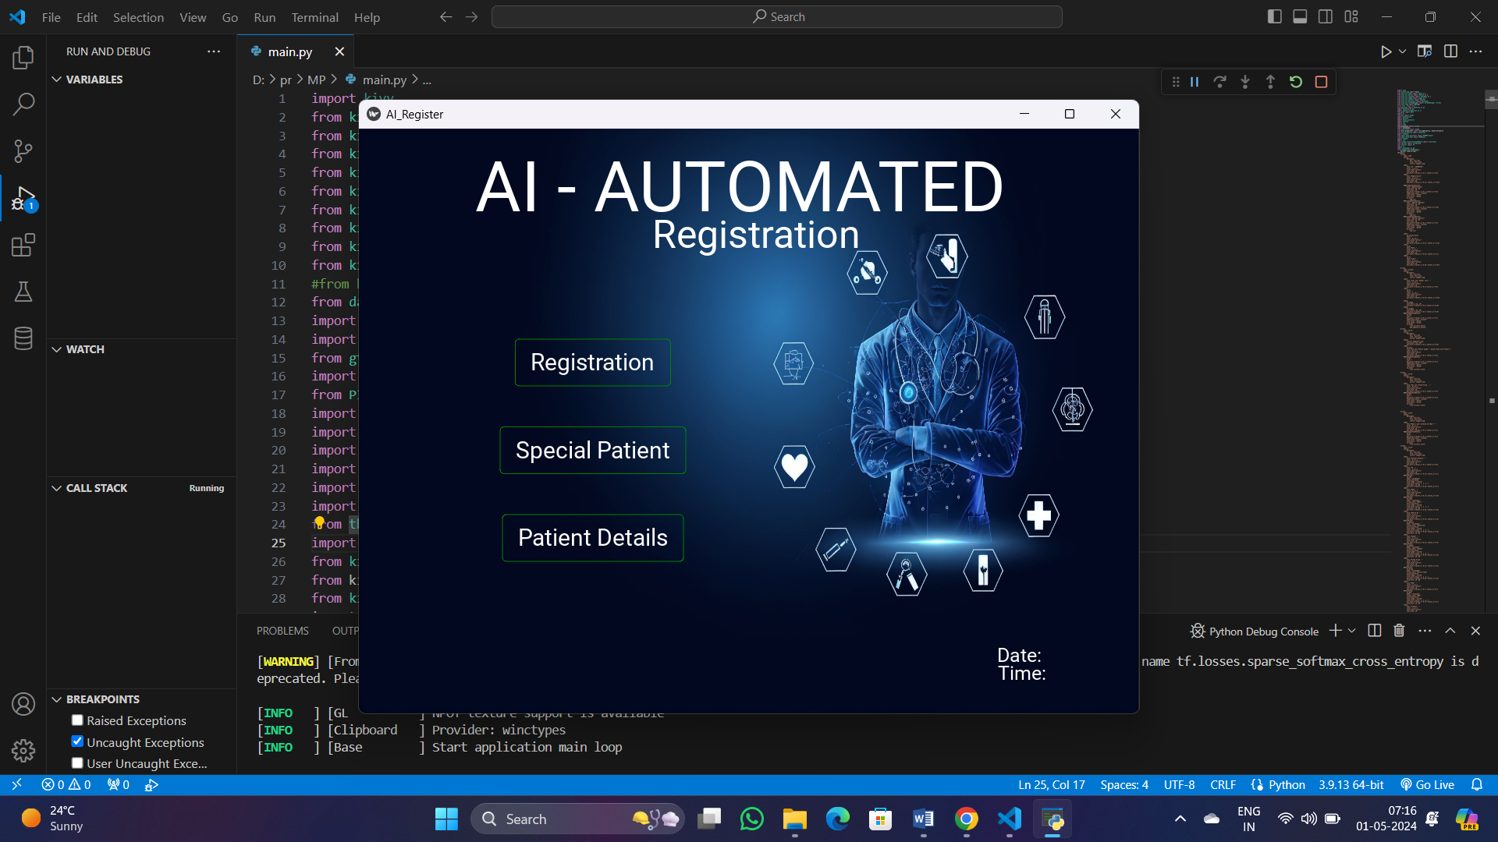

Slide 32
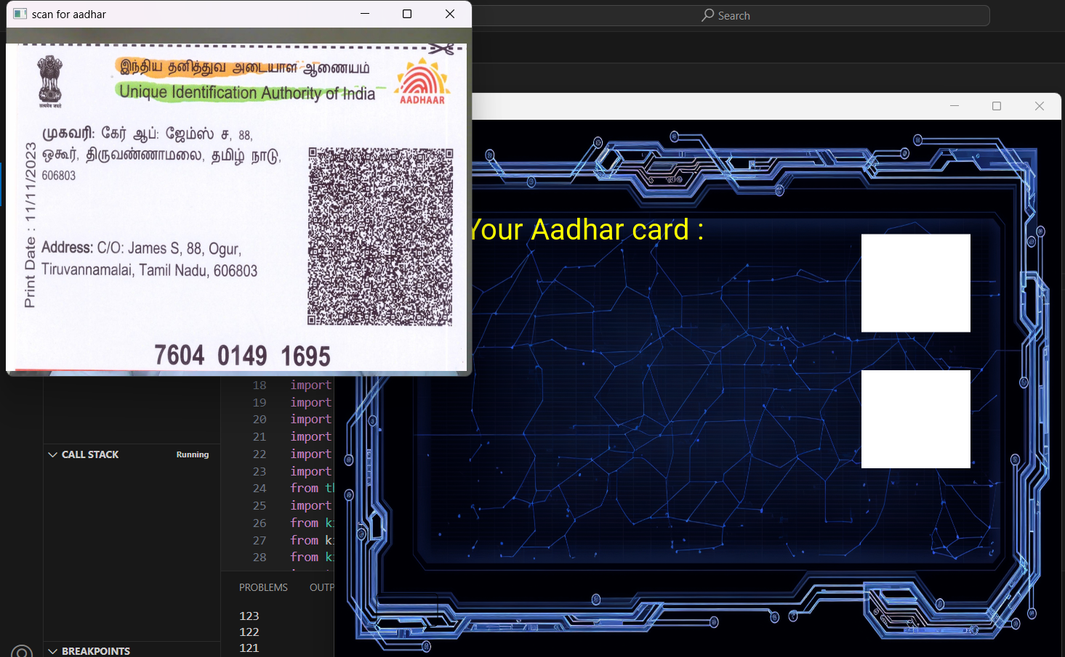

Slide 33
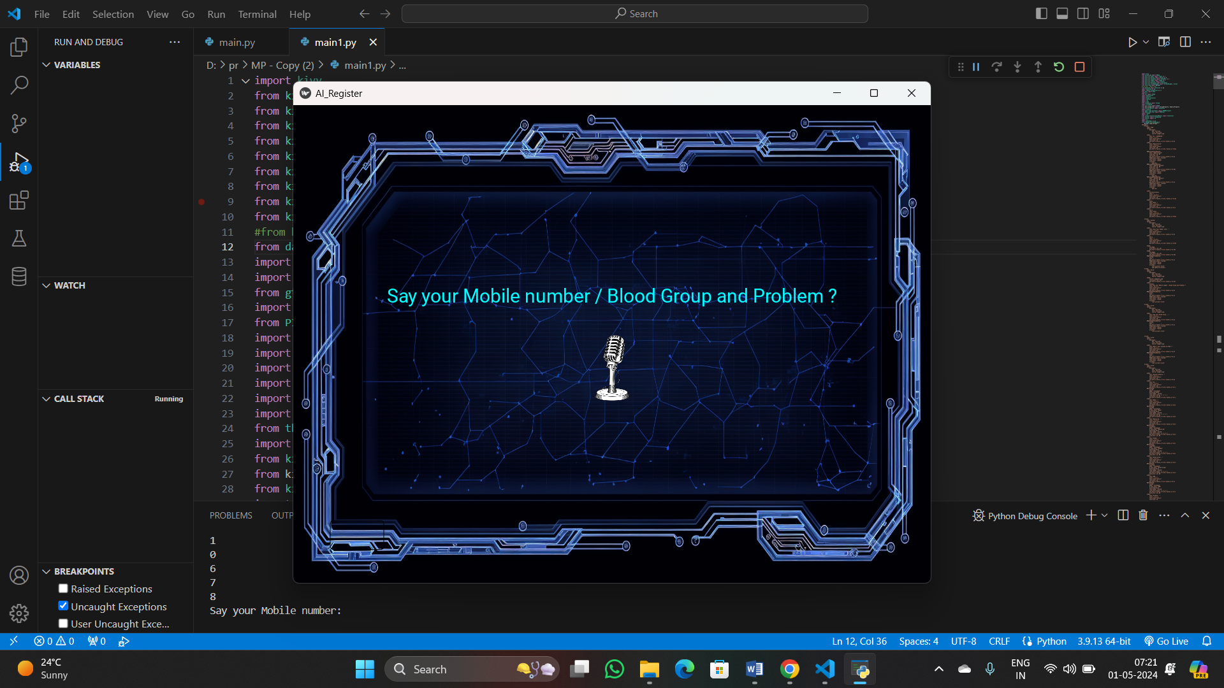

Slide 34
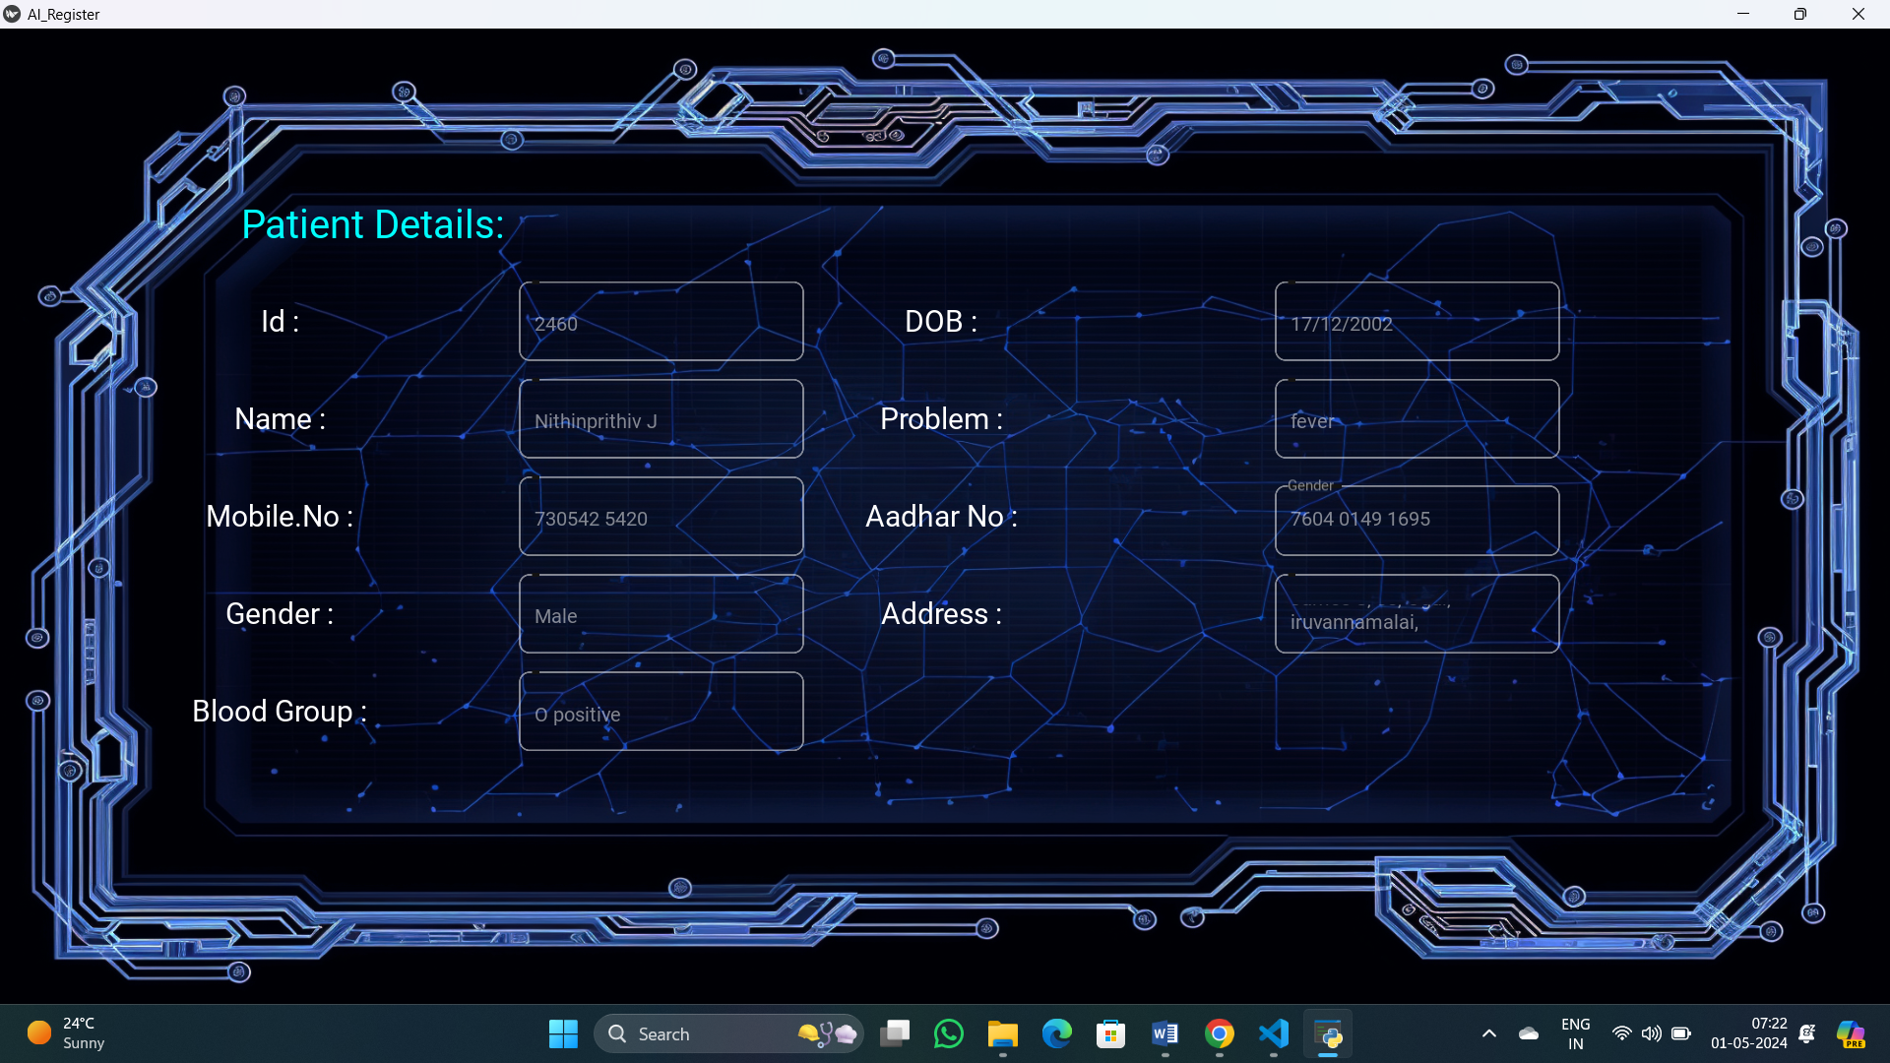

Slide 35
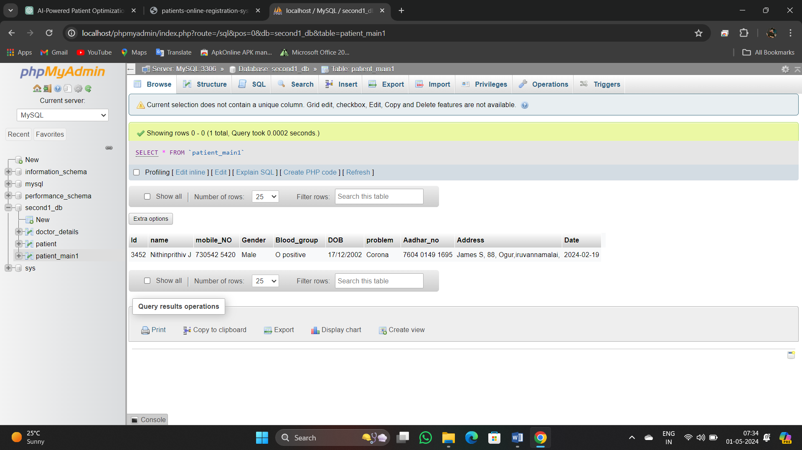

Slide 36
FUTURE ENHANCEMENT
The AI-powered patient registration and data optimization system promise to revolutionize healthcare delivery. With advanced predictive analytics, real-time monitoring, and integration with wearable devices, healthcare providers can anticipate patient needs and respond swiftly to emerging issues. Incorporating natural language processing and blockchain technology ensures richer data insights and enhanced data security. Virtual health assistants offer personalized guidance, while genomic data integration enables precision medicine approaches tailored to individual genetic profiles. Augmented reality enhances patient education, and improved data visualization tools facilitate informed decision-making. Advancements in interoperability standards promote seamless data exchange, fostering a more connected and patient-centric healthcare ecosystem.

Slide 37


CONCLUSION
In conclusion, the proposed AIdriven registration system offers a transformative solution to streamline patient registration processes, improve data accuracy, and enhance the overall healthcare experience. By leveraging automation, digital forms, and predictive analytics, healthcare institutions can optimize operational efficiency, ensure data security, and provide personalized care. This shift towards AIdriven registration marks a significant advancement in healthcare administration, promising improved outcomes and satisfaction for both patients and providers.

Slide 38
THANK YOU!

